Slide 1
Quality Assurance Project Plans
Orientation for EPN Staff
7/7/2025
TRCCOMPANIES.COM

Slide 2
Agenda
Introduction to QAPPs and EPA's Quality Program
'QAPP or Not' examples
Translating Workplans to QAPPs
How TRC/EPN Can Help

Slide 3
Quality Assurance Project Plans (QAPPs)
A QAPP (kwapp, kwopp, q-a project plan, q-a-p-p) is a systematic project plan to ensure that environmental data collected and used in a project are scientifically valid, legally defensible, and of known and documented quality.
QAPPs provides guidance defining:
WHAT do researchers want to know (what question is being asked)
HOW data will be collected
HOW data will be analyzed
HOW data will be determined “of sufficient quality” (i.e. “good enough”) to answer the original question
WHO is responsible for each task.
For example, your QAPP might describe how many soil samples you will take over a specific area, how they will be collected and taken to a lab for analysis, and who is responsible for each component.

Slide 4
Environmental Information Operations (EIO)
Definition: The collection, production, evaluation, or use of environmental information by or for EPA and the design, construction, operation, or application of environmental technology.
Examples:
Data Collection Ambient air or water quality monitoring using sensors or field equipment. Sampling soil, sediment, groundwater, or hazardous waste for laboratory analysis. Gathering emissions data from industrial facilities. Using drones or satellites for remote sensing of environmental conditions. | Environmental Modeling Calculate GHG emissions across a supply chain Calculate GHG reductions from interventions Geospatial Information Systems Mapping contaminated sites or watershed boundaries using GIS tools. Data Management & Storage Entering sampling data into EPA-approved databases
All projects with EIO require QA documentation: Quality Management Plans (QMP), QA Project Plans (QAPP)

Slide 5
EPA's Quality Program - Why?
🏆 Benefits of EPA's Quality Program
✔Contributes to successful projects
✔Increases data confidence (you know data are useful)
✔Supports sound science
✔Boosts efficiency (saves time)
✔Reduces vulnerabilities (financial, legal, etc.)
✔Strengthens defensibility of decisions
⚠️ Risks of Poor Quality
× Flawed data → Poor decisions
× Negative press & reputation damage
× Wasteful spending (repeating projects)
× Legal/financial challenges (IQA, lawsuits)

Slide 6
When are QAPPs required?
Grantmakers Subawardee Activity Description | QAPP Needed? | Rationale
1. “Key activities include water sampling, community engagement, and collaboration with various partners …” | Yes | Primary data collection (i.e., direct monitoring or sampling of environmental media)
2. “conduct comprehensive energy survey of residential and commercial buildings on tribal lands…primary goal is to gather data on energy consumption to inform future investments in renewable energy" | Yes | Secondary data collection (i.e., environmental data/information being used for purposes other than which they were originally collected)

Slide 7
When are QAPPs required?
Grantmakers Subawardee Activity Description | QAPP Needed? | Rationale
3. “this project will empower youth and underserved communities to address waste management issues through curriculum development, teaching training and community engagement” | Unlikely | No environmental data being collected and no environmental decisions being made
4. “Surveying population to gauge their awareness of healthy home incentives & available resources” | Unlikely | No environmental data collection and no environmental decisions being made

Slide 8
When are QAPPs required?
Scenario | QAPP Needed? | Rationale
5. Developing and distributing environmental education material to inform the public on risk of asthma due to poor air quality, and asking residents for input on optimal placement of stationary air monitors | Maybe... | Development and distribution of education materials likely does not need a QAPP. However, if survey results inform environmental decisions (i.e., placement of air quality monitors), then a QAPP is required.
6. Surveying population to gauge their awareness of healthy home incentives & available resources, and having residents perform scratch and magnet tests to test for lead pipes and report results | Maybe... | Survey results of awareness of incentives & resources are not likely to be considered environmental data. However, testing for presence of lead pipes is environmental data collection and a QAPP is required (especially if that test is quantitative)

Slide 9
How can projects be revised to minimize QAPPs?
Scenario | QAPP Needed? | Rationale
7. Upgrading HVAC systems and installing MERV 16 filters to improve indoor air quality inside community resilience centers or public buildings and collection/analysis of indoor and outdoor air quality measurements using low-cost sensors | Yes or No | Is collection and analysis of indoor and outdoor air quality measurements using low cost sensors necessary to show efficiency of removing PM for commercially available technologies? Would it be more cost effective and avoid a QAPP if indoor/outdoor air quality were not collected and analyzed?
8. The project aims to address illegal dumping and waste burning on tribal land … plan to inventory illegal dumpsites, conduct community cleanups, and provide environmental education | Yes or No | If the inventory of illegal dumpsites involves collection/analysis of primary or secondary data, then a QAPP would be triggered. Can this inventory be modified so that dumpsites are identified but a QAPP is not triggered?

Slide 10
QAPP Components
A: Project Management | B: Data Generation and Acquisition
Who will be involved in the project? What is the environmental problem? What is the background history of the problem? What questions must be answered? How will the data be used? What decisions will be made with the data? What type, quantity and quality of data are needed to support scientifically sound decisions? | What is the sampling design & rationale? What sample collection methods will be used? What QC activities will be performed to assure that representative samples are collected? What field & laboratory procedures will be used? What QC activities will be performed to assure accurate, precise and sensitive data are collected? How will sample data be managed? Will secondary data also be used?
C: Assessment and Oversight | D: Data Review: Verification, Validation & Usability Assessment
How will you check to make sure that the project is being conducted as described in the QAPP. are the samplers collecting samples at the correct locations? is the laboratory generating accurate data? What interim and final reports will be generated and provided to management and data users? | How will you check that individual data collection tasks were completed correctly? How will you determine that individual sample results are acceptable or unacceptable based on QC data? How will you determine the limitations on a data set? How will you assess the entire set of project data to determine whether the data are “good” enough to use in making project decisions and drawing conclusions?

Slide 11
Workplan 🡪 QAPP: Heat Pump Installations
Project: Replace residential propane heating systems with electric heat pumps
CPRG Workplan | CPRG QAPP EIO
CO2e reductions estimation inputs: Statewide propane usage data from the Center for Energy and Environment Heat pump electricity usage from academic study Average carbon intensity in state electricity mix from Energy Information Administration (EIA) GHG intensity of propane in residential homes (EIA) Planned quantity of heat pump installations | EIO that produce actual emissions reductions estimates: Baseline: collection of baseline inventory of existing residential heating systems designated for replacement with heat pumps. Intervention: Tracking and recordkeeping of heat pump installation & energy savings for life of project: Number and size of heat pumps installed. Collect energy consumption data from the local utility for each address. Calculate energy savings using tools noted in the approved workplan. GHG Calculation: Conversion of monthly usage rates to estimates of emissions reductions consistent with methods proposed in approved workplan for CO2e, PM2, NOx

Slide 12
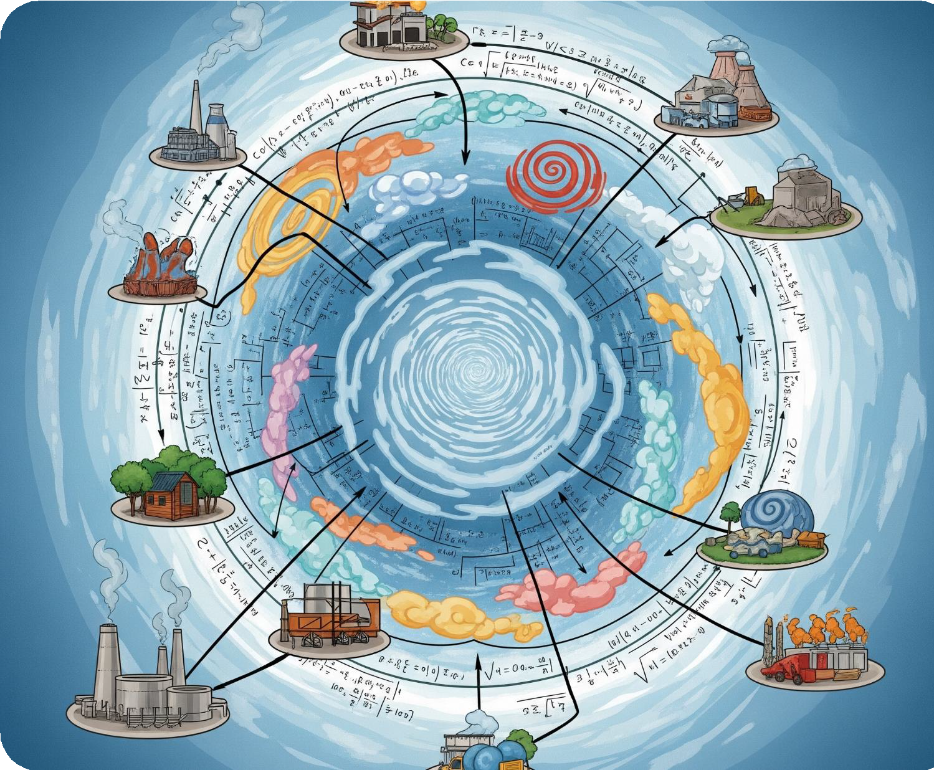
How Can TRC Support?
Workplan review for QAPP guidance
QAPP development and review
Support responses to EPA QAM review of QAPPs
Epa- support@TRCcompanies.com
TRCCOMPANIES.COM

Slide 13
Thanks!
Email Us:
info@environmentalprotection network.org
Visit Us:
environmentalprotectionnetwork.org
TRCCOMPANIES.COM

Slide 14
Projects Requiring a QAPP
Superfund
Brownfields
Water Quality Monitoring
Environmental Justice
Climate Pollution Reduction Act
Nonpoint Source (319)
Long Island Sound
Lake Champlain Basin Program

Slide 15
Introduction: EPA's Quality Program
Objective: Manages the collection, production, evaluation or use of environmental
information.
Primary goal: Ensure that environmental information are of known and documented
quantity and quality to support the intended use of the information.
Under the EPA Quality Program, EPA offices/ organizations develop and implement supporting quality programs.
Recipients of EPA financial assistance (e.g., grantees) must implement a conforming quality program

Slide 16
Environmental Information & Environmental Technology
Environmental Information: Data and information that describe environmental processes or conditions which support EPA's mission of protecting human health and the environment.
Examples:
− Measurement of environmental parameters
− Analytical results of environmental
conditions
− Data and information collected from chemical, physical, or biological samples
− Databases, surveys, literature
− Tools, instruments, observations, lab operations
− Models, geographic information systems (GIS)
− Habitat assessments
Environmental Technology: An all- inclusive term for systems, devices and their components (including hardware, methods and techniques) that remove pollutants and/or contaminants or prevent them from entering the environment.
Examples:
− Pollution monitoring
− Waste treatment processes
− Site remediation

