Slide 1
Presenter
James Drummond
James Drummond
Mr. Drummond is a retired EPA attorney who specialized in grants and appropriations law during his tenure at EPA’s Office of General Counsel. He left EPA in March 2025. This presentation is based on publicly available information Mr. Drummond provided at the 2023 Brownfields Conference. However, Mr. Drummond does not speak for EPA on any of the matters addressed during this presentation.

Slide 2

Avoiding Adverse Audit Findings
Timely Disbursement of EPA Funds
Recipients (other than states) must minimize time elapsing between draw down and disbursement (maximum 5 business days).
Drawdowns must be based on actual costs incurred (e.g., payroll, contractor invoices) rather than estimates or “even” amounts each month or week based on anticipated cash flow. Recipients do not have to pay bills or make payroll first but must disburse within 5 business days of drawdown or repay EPA if disbursements are delayed beyond 15 business days.
Automated Standard Application for Payment (ASAP) system allows almost instantaneous payment.
All EPA recipients must participate in ASAP.

Slide 3

Avoiding Adverse Audit Findings
How to Survive an Improper Payment Review
Auditors (Single Audit, Inspector General, Agency Staff) conduct reviews of a sample of recipient drawdowns to monitor compliance with regulatory requirements.
Recipients must provide accounting documentation to support the amount of funds drawn down and timely disbursement.
Examples of documentation include:
Payroll records showing compensation charged to Federal financial assistance agreement based on contemporaneous estimates of actual hours performing work under the assistance agreement. Charges based on percentage of time in budgets must be adjusted to reflect after the fact determinations of hours worked.
Invoices from contractors or payment requests from subrecipients.
Travel vouchers, receipts from hotels, etc. to support travel reimbursement.
Procurement records documenting compliance with competition requirements.

Slide 4
Financial Management Common Sense Tips
Be sure your records tell a complete story – tracing costs from planning through drawdown and payment, clearly showing the need, approvals, proper accounting, and receipt of goods and services.
You can only have one set of books. Your financial management system must be used for all accounts.
Payroll records, including timesheets, must account for 100% of the time of every employee. This includes non-working hours (leave etc.) and all activities charged by each employee.
Employees charged to more than one cost center must charge actual hours spent on each; they cannot be paid based on a pre-determined allocation. Non-working hours must be properly prorated among all cost centers or charged to the general ledger.
Charges have to make sense. For example, you cannot charge an employee’s travel to a different account than his/her payroll for the same day. The appropriate account should be charged for both.

Slide 5


Timekeeping and Financial Management Requirements
EPA has on-line applicant/recipient grant training available online at https://www.epa.gov/grants/epa-grants-management-training-applicants-and-recipients.

Slide 6
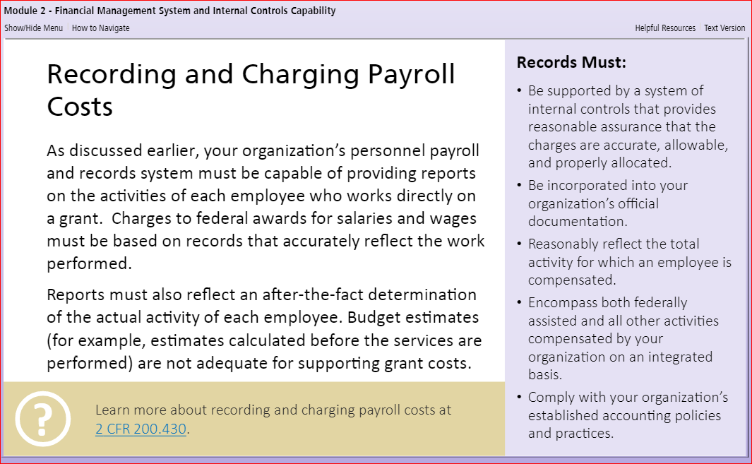
Timekeeping and Financial Management Requirements

Slide 7
Procurement Under the UGG
DON’T TAKE SHORT CUTS IN PROCUREMENT IN ORDER TO DRAW DOWN FUNDS
All recipients (other than states and tribes) that procure a contractor must comply with the Procurement Standards in 2 CFR Part 200 and 2 CFR Part 1500.
  * States and tribes are subject to 2 CFR 200.322 and 2 CFR 200.323 relating to domestic preferences and procurement of recycled materials as well as EPA’s 40 CFR Part 33 Disadvantaged Business Participation rule.
Per 2 CFR 200.319, full and open competition is the norm when procuring goods and services. Contracts under $10,000 can be entered into without competition but be careful not to circumvent competition—rotate purchases among qualified sources.
EPA has posted Best Practice Guide for Procuring Services, Supplies, and Equipment Under EPA Assistance Agreements as guidance for non-state/tribal recipients.

Slide 8
Procurement Under the UGG
Conflicts of interest are prohibited by 2 CFR 200.318(c).
Personal conflicts of interest: “No employee, officer, or agent may participate in the selection, award, or administration of a contract supported by a Federal award if he or she has a real or apparent conflict of interest. Such a conflict of interest would arise when the employee, officer, or agent, any member of his or her immediate family, his or her partner, or an organization which employs or is about to employ any of the parties indicated herein, has a financial or other interest in or a tangible personal benefit from a firm considered for a contract. The officers, employees, and agents of the non-Federal entity may neither solicit nor accept gratuities, favors, or anything of monetary value from contractors or parties to subcontracts.”
Organizational Conflicts of Interest
“If the [recipient] has a parent, affiliate, or subsidiary organization that is not a State, local government, or Indian tribe, the non-Federal entity must also maintain written standards of conduct covering organizational conflicts of interest. Organizational conflicts of interest means that because of relationships with a parent company, affiliate, or subsidiary organization, the non-Federal entity is unable or appears to be unable to be impartial in conducting a procurement action involving a related organization.”

Slide 9
CONSULTANT FEE CAP
Limits the amount of compensation for individual consultants that recipients may charge to EPA agreements to Level IV of the Federal Executive Level. [*Does not include consultant’s overhead or travel costs.]
STATUTORY!!!! Implementing regulations at 2 CFR 1500.10. cannot be waived. States and tribes must comply.
When the Cap applies is based on whether the recipient selects, directs, or controls the consultant along the same lines as an employee.
Contracts with multi-employee consulting firms rarely trigger consultant fee cap but terms of contract are important.
Consultants are contractors even if they receive an IRS 1099 from recipient—competitive procurement rules apply!!!
Cap does not apply to fixed priced contracts for discrete products such as studies—payments may be made in stages with upfront payment at time of contract award.
Example--$10,000 noncompetitive contract for a study with $5,000 upfront and remainder at time of delivery of study or sampling analysis.
Rotate contracts among qualified sources.

Slide 10

Questions?
This Photo by Unknown Author is licensed under CC BY-SA

