Slide 1
Solar for All
Pre-Award Checklist & 1-1 Support
9/16/24
epa-support@trccompanies.com

Slide 2
About EPN
The Environmental Protection Network is a 501c3 nonproﬁt
Small staﬀ and over 650 EPA alumni across the country
Focused on building the capacity of environmental agencies and the communities they serve to truly address the most urgent health and environmental crises
Notes:
The Environmental Protection Network (EPN) was founded in January 2017 and now has over 600 EPA alumni across the country volunteering their time to protect the integrity of EPA, human health, and the environment. We harness the expertise of former EPA career staff and confirmation-level appointees from Democratic and Republican administrations to provide the unique perspective of former regulators with decades of historical knowledge and subject matter expertise.

Slide 3
EPN’s Pro Bono Technical Assistance
Launched 3 years ago
Provide TA to disadvantaged communities, community-serving NGOs, and under-resourced agencies
Assisted over 1,000 requests
Helped communities raise over $530 million in federal funding
Notes:
The Environmental Protection Network (EPN) was founded in January 2017 and now has over 600 EPA alumni across the country volunteering their time to protect the integrity of EPA, human health, and the environment. We harness the expertise of former EPA career staff and confirmation-level appointees from Democratic and Republican administrations to provide the unique perspective of former regulators with decades of historical knowledge and subject matter expertise.

Slide 4
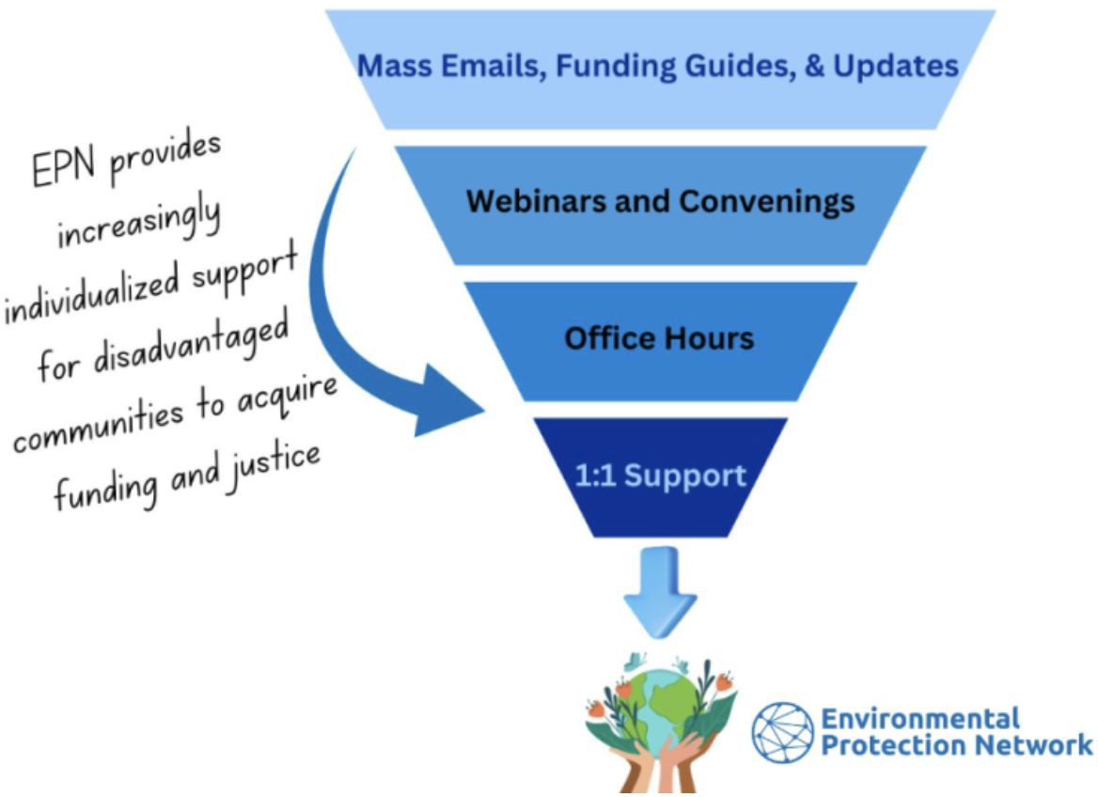
\ EPN’s Pro Bono Technical Assistance
Notes:
The Environmental Protection Network (EPN) was founded in January 2017 and now has over 600 EPA alumni across the country volunteering their time to protect the integrity of EPA, human health, and the environment. We harness the expertise of former EPA career staff and confirmation-level appointees from Democratic and Republican administrations to provide the unique perspective of former regulators with decades of historical knowledge and subject matter expertise.

Slide 5
Relationship with TRC
EPN gets most of its funding from private foundations, and about 10% from TCTACs
Using foundation funding, hired TRC to assist SFA selectees reach agreement with EPA:
− Pre-Award Introduction/Checklist and Resources
− Webinars and Oﬃce Hours
− 1:1 support: epa-support@trccompanies.com
Notes:
The Environmental Protection Network (EPN) was founded in January 2017 and now has over 600 EPA alumni across the country volunteering their time to protect the integrity of EPA, human health, and the environment. We harness the expertise of former EPA career staff and confirmation-level appointees from Democratic and Republican administrations to provide the unique perspective of former regulators with decades of historical knowledge and subject matter expertise.

Slide 6
Workshop Agenda
Welcome and Introductions
Review Pre-Award Introduction and Checklist
Questions and Answers
Notes:
The Environmental Protection Network (EPN) was founded in January 2017 and now has over 600 EPA alumni across the country volunteering their time to protect the integrity of EPA, human health, and the environment. We harness the expertise of former EPA career staff and confirmation-level appointees from Democratic and Republican administrations to provide the unique perspective of former regulators with decades of historical knowledge and subject matter expertise.

Slide 7
Checklist Review
Solar for All Pre-Award Checklist and Introduction
Finalize workplans and budgets by 12/31/24
Notes:
The Environmental Protection Network (EPN) was founded in January 2017 and now has over 600 EPA alumni across the country volunteering their time to protect the integrity of EPA, human health, and the environment. We harness the expertise of former EPA career staff and confirmation-level appointees from Democratic and Republican administrations to provide the unique perspective of former regulators with decades of historical knowledge and subject matter expertise.

Slide 8
Checklist Review
Step 1: Set up internal grant management processes for EPA compliance
Start any legal or organizational approvals to avoid delays
Finalize project team
Develop workplan, finance and accounting system, reporting protocols
Notes:
The Environmental Protection Network (EPN) was founded in January 2017 and now has over 600 EPA alumni across the country volunteering their time to protect the integrity of EPA, human health, and the environment. We harness the expertise of former EPA career staff and confirmation-level appointees from Democratic and Republican administrations to provide the unique perspective of former regulators with decades of historical knowledge and subject matter expertise.

Slide 9
Checklist Review
Step 2: Take EPA’s Mandatory Grants Management and Budgeting Training Courses
Mandatory for new awardees, recommended for all admin and financial staff to brush up on EPA grant management
Notes:
The Environmental Protection Network (EPN) was founded in January 2017 and now has over 600 EPA alumni across the country volunteering their time to protect the integrity of EPA, human health, and the environment. We harness the expertise of former EPA career staff and confirmation-level appointees from Democratic and Republican administrations to provide the unique perspective of former regulators with decades of historical knowledge and subject matter expertise.

Slide 10
Checklist Review
Step 3: Complete Pre-Award Certification Process, Including Form 6600-01
Required for non-profits receiving more than $200K; ensure applicants have adequate admin and financial systems to manage EPA funds
Complete Form 6600-01 (questions on accounting, financial management, payroll, travel, procurement)
Update your policies and procedures (e.g., Employee Handbook) to reflect Form 6600-01 answers, complete the 6600 checklist, submit to EPA
Notes:
The Environmental Protection Network (EPN) was founded in January 2017 and now has over 600 EPA alumni across the country volunteering their time to protect the integrity of EPA, human health, and the environment. We harness the expertise of former EPA career staff and confirmation-level appointees from Democratic and Republican administrations to provide the unique perspective of former regulators with decades of historical knowledge and subject matter expertise.

Slide 11
Checklist Review
Step 4: Review EPA Grant Award Agreement and Terms and Conditions
Closely review and confirm project details (entity name, budget, dates, project periods)
Share any errors with your EPA PO
Notes:
The Environmental Protection Network (EPN) was founded in January 2017 and now has over 600 EPA alumni across the country volunteering their time to protect the integrity of EPA, human health, and the environment. We harness the expertise of former EPA career staff and confirmation-level appointees from Democratic and Republican administrations to provide the unique perspective of former regulators with decades of historical knowledge and subject matter expertise.

Slide 12
Checklist Review
Step 5: Plan Project Procurement To Be Compliant with Federal Guidelines, BABA and the Davis-Bacon Act
Review project partner roles
Read CESA primers on BABA and DBA
Add BABA and DBA language to contract templates
Notes:
The Environmental Protection Network (EPN) was founded in January 2017 and now has over 600 EPA alumni across the country volunteering their time to protect the integrity of EPA, human health, and the environment. We harness the expertise of former EPA career staff and confirmation-level appointees from Democratic and Republican administrations to provide the unique perspective of former regulators with decades of historical knowledge and subject matter expertise.

Slide 13
Checklist Review
Step 6: Meet with All Project Partners to Collect Any Project Updates
Your partners may identify updates that deviate from your SFA proposal’s workplan or budget
Notes:
The Environmental Protection Network (EPN) was founded in January 2017 and now has over 600 EPA alumni across the country volunteering their time to protect the integrity of EPA, human health, and the environment. We harness the expertise of former EPA career staff and confirmation-level appointees from Democratic and Republican administrations to provide the unique perspective of former regulators with decades of historical knowledge and subject matter expertise.

Slide 14
Checklist Review
Step 7: Respond to EPA’s Comments & Update Workplan, Budget, and Proposal Documents as Required
Likely revisions to cost categories, deliverable dates
Use Track Changes in your workplan and budget
Respond to EPA’s comments clearly and thoroughly
Notes:
The Environmental Protection Network (EPN) was founded in January 2017 and now has over 600 EPA alumni across the country volunteering their time to protect the integrity of EPA, human health, and the environment. We harness the expertise of former EPA career staff and confirmation-level appointees from Democratic and Republican administrations to provide the unique perspective of former regulators with decades of historical knowledge and subject matter expertise.

Slide 15
Checklist Review
Step 8: Receive Your EPA Award Agreement, Review, and Accept!
Acceptance is assumed unless objections are raised within 21 days
Notes:
The Environmental Protection Network (EPN) was founded in January 2017 and now has over 600 EPA alumni across the country volunteering their time to protect the integrity of EPA, human health, and the environment. We harness the expertise of former EPA career staff and confirmation-level appointees from Democratic and Republican administrations to provide the unique perspective of former regulators with decades of historical knowledge and subject matter expertise.

Slide 16
Checklist Review
Step 9: Execute Contracts with Partners
Your EPA Award Agreement provides a legal basis to execute partner contracts
Enroll in the Automated Standard Application for Payments (ASAP) system (EPA will provide instructions after contracting)
Notes:
The Environmental Protection Network (EPN) was founded in January 2017 and now has over 600 EPA alumni across the country volunteering their time to protect the integrity of EPA, human health, and the environment. We harness the expertise of former EPA career staff and confirmation-level appointees from Democratic and Republican administrations to provide the unique perspective of former regulators with decades of historical knowledge and subject matter expertise.

Slide 17
Discussion
Resources
EPN’s SFA Pre-Award Resources Page
SFA Pre-Award Introduction and Checklist
Pro bono 1-1 support available: epa-support@trccompanies.com

