Slide 1
Air quality (PM_{2.5})-related health effects of agriculture
EPN All Hands Call Webinar
October 15, 2021
Jason Hill, Professor
Bioproducts and Biosystems Engineering
University of Minnesota

Slide 3
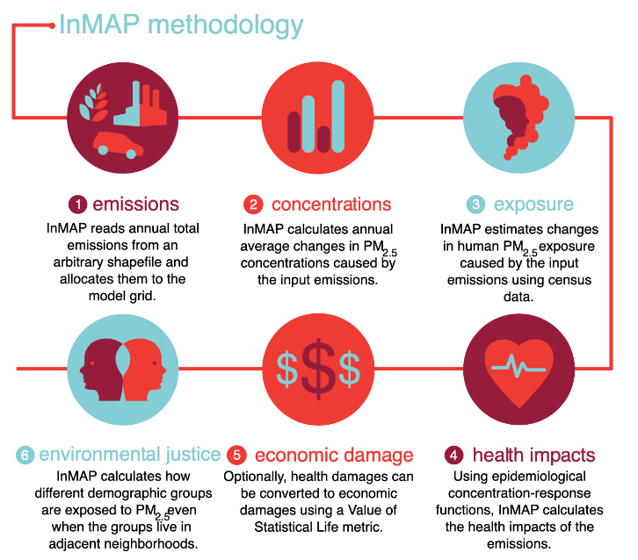
Tessum et al. (2017)

Slide 4
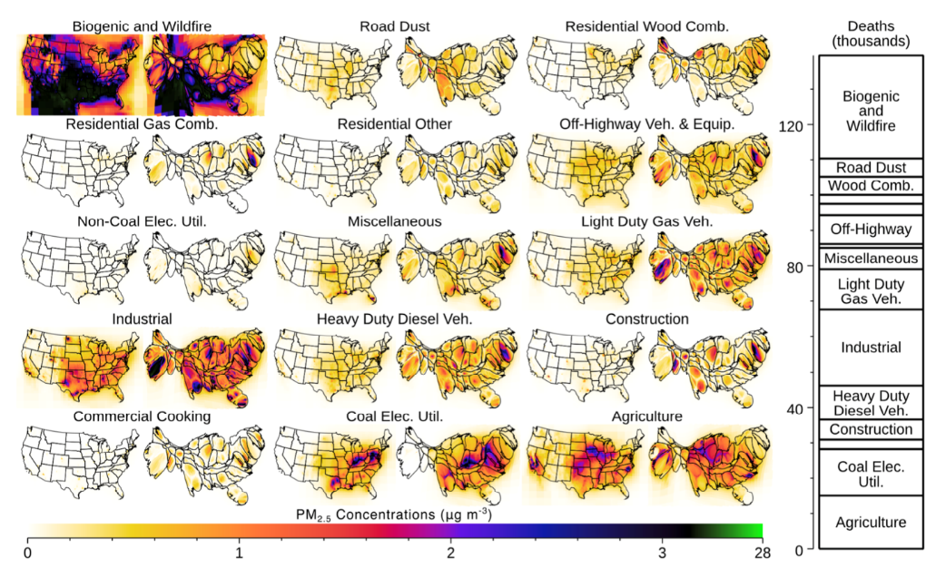
Tessum et al. (2019) PNAS

Slide 5
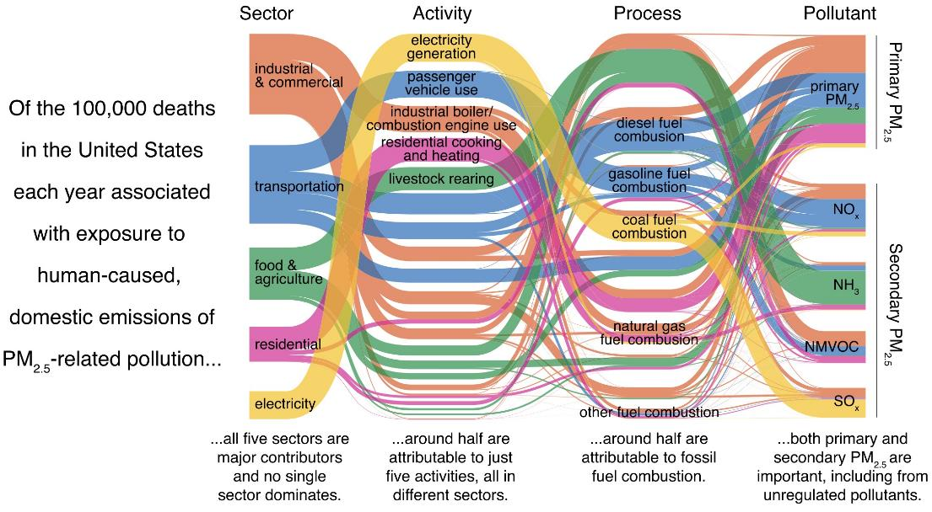
Thakrar et al. (2020) ES&T Lett.

Slide 6
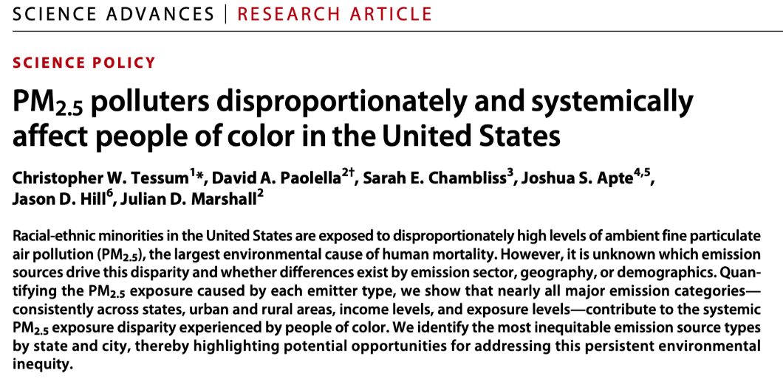
Tessum et al. (2021) Sci. Adv.

Slide 7
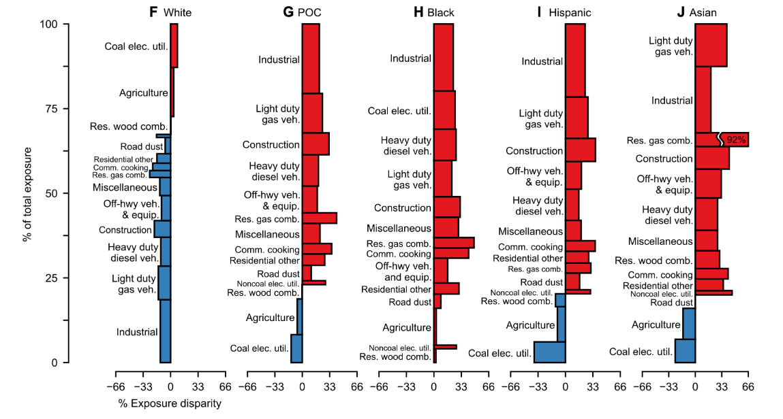
Tessum et al. (2021) Sci. Adv.

Slide 8
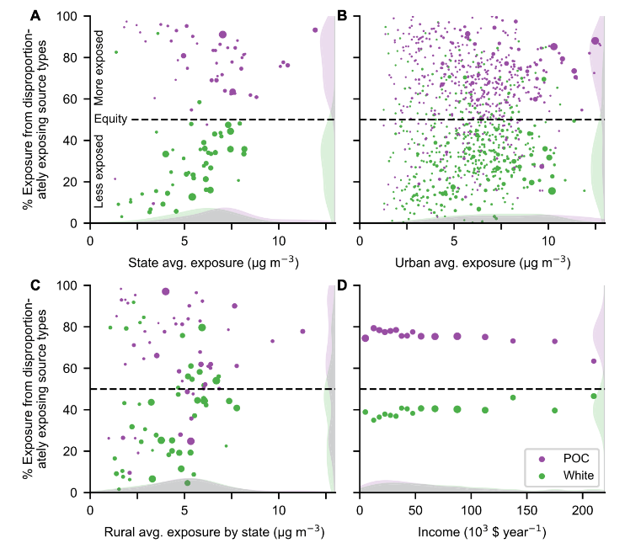
Tessum et al. (2021) Sci. Adv.

Slide 9
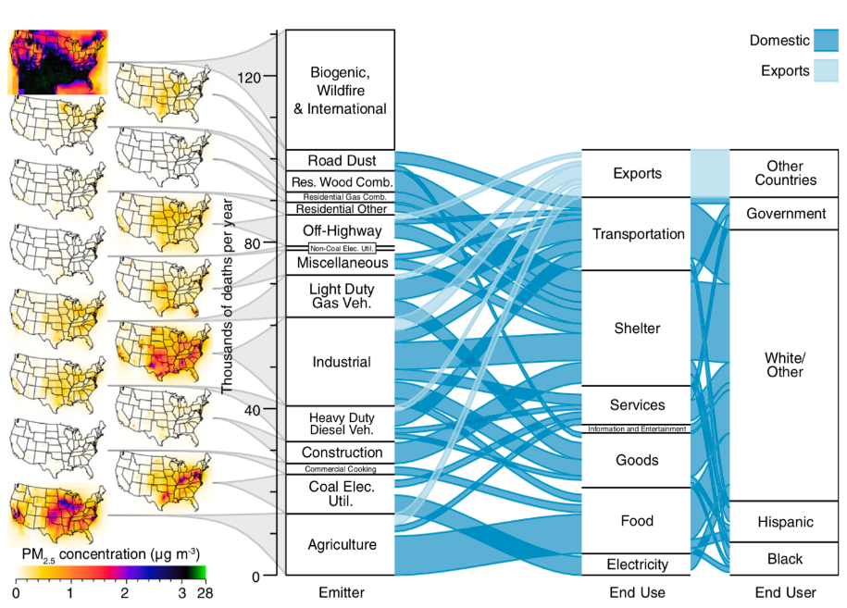
Tessum et al. (2019) PNAS

Slide 10
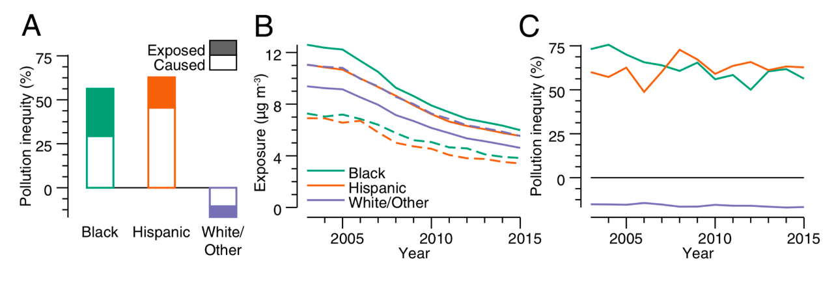
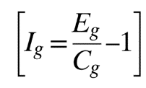
Tessum et al. (2019) PNAS

Slide 11
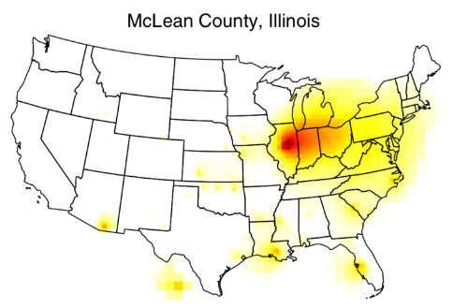
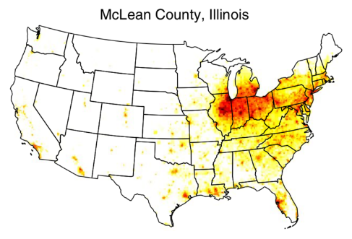
Hill et al. (2019) Nat. Sust.

Slide 12
https://www.pnas.org/content/118/20/e2013637118
Other information on Twitter: @jdhill
Domingo et al. (2021) PNAS

Slide 13
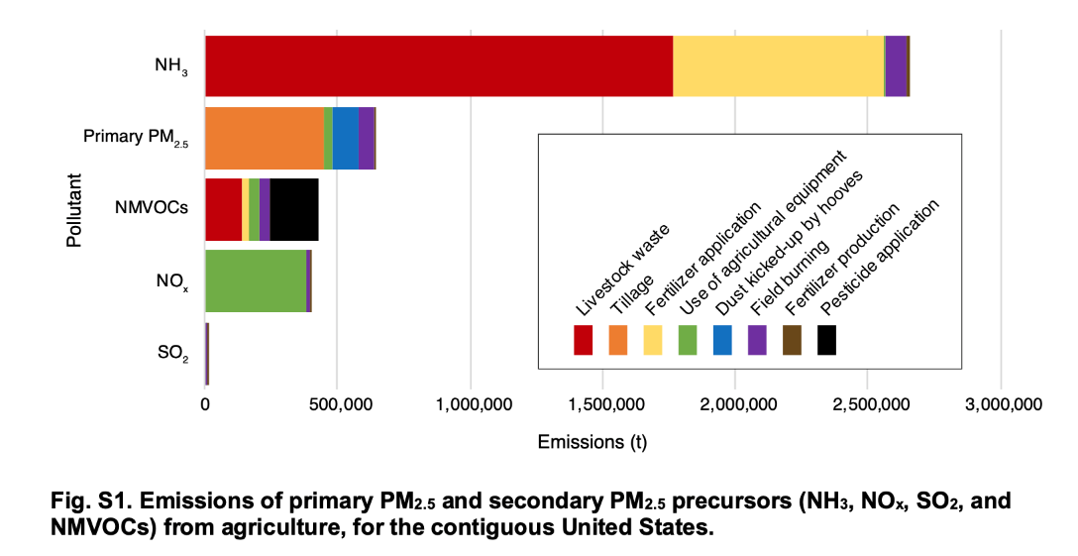
Domingo et al. (2021) PNAS

Slide 14
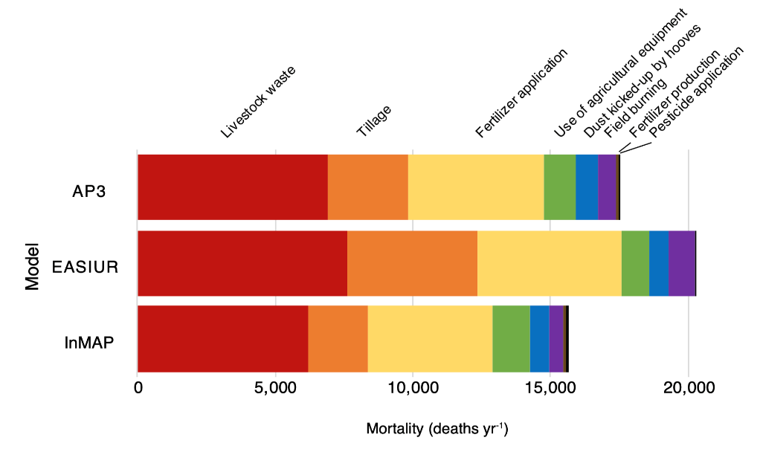
Domingo et al. (2021) PNAS

Slide 15
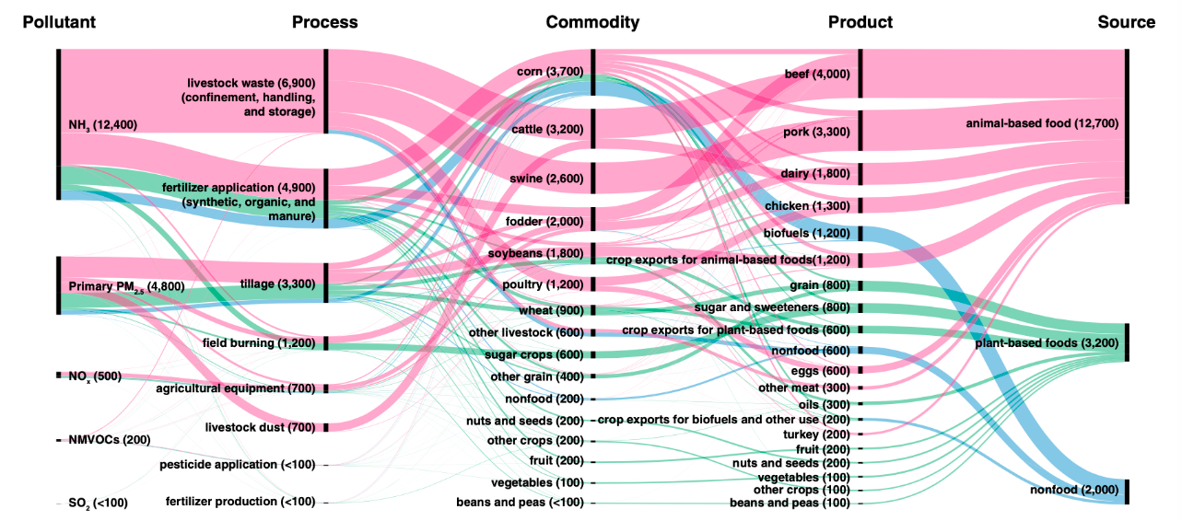
Domingo et al. (2021) PNAS

Slide 16
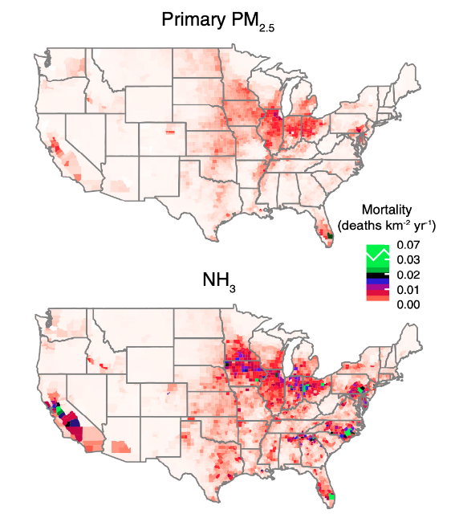
Domingo et al. (2021) PNAS

Slide 17
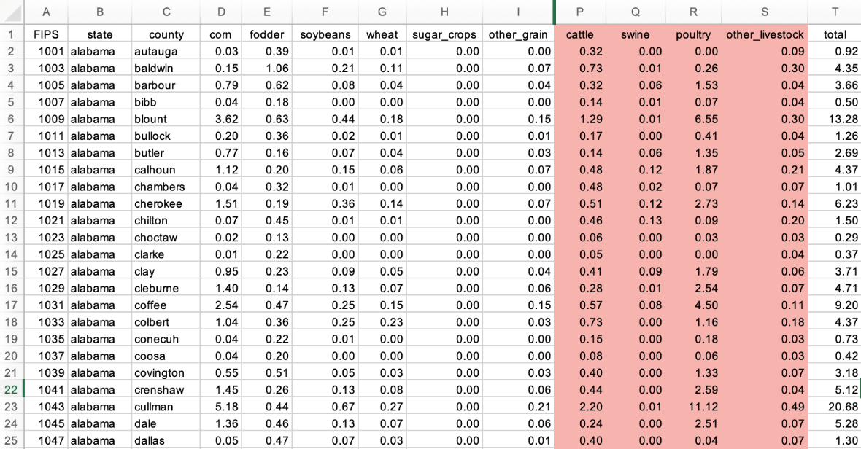
Domingo et al. (2020) PNAS

Slide 18
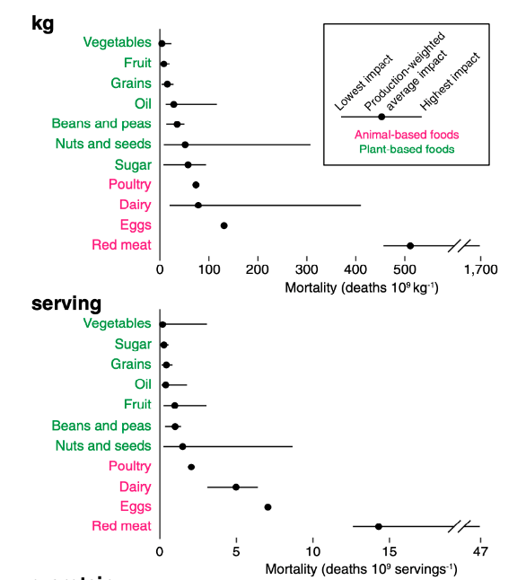
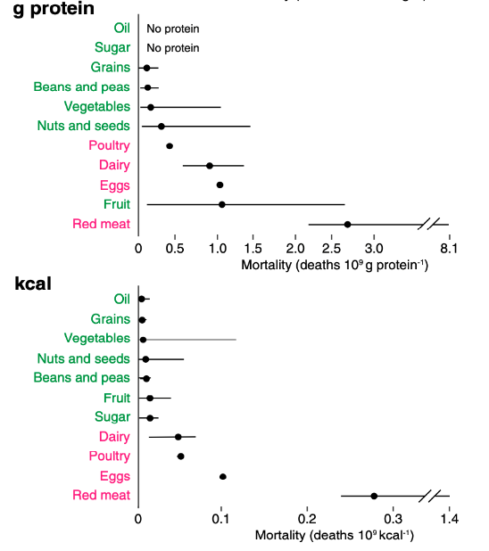
Domingo et al. (2021) PNAS

Slide 19
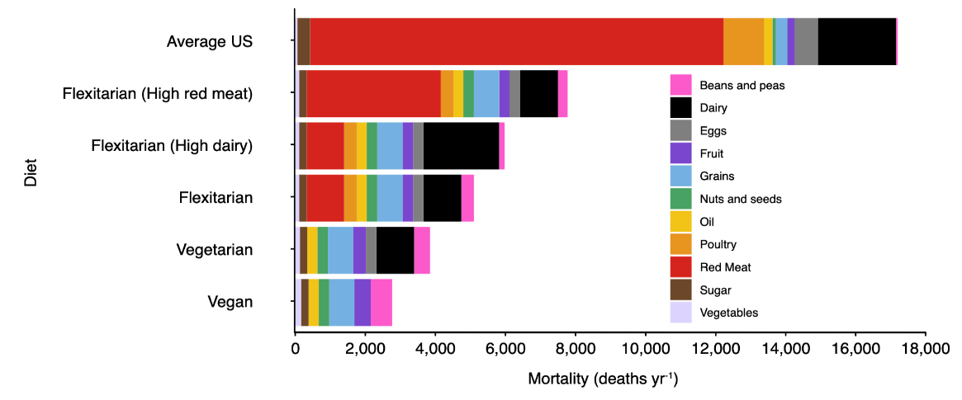
Domingo et al. (2021) PNAS

Slide 20
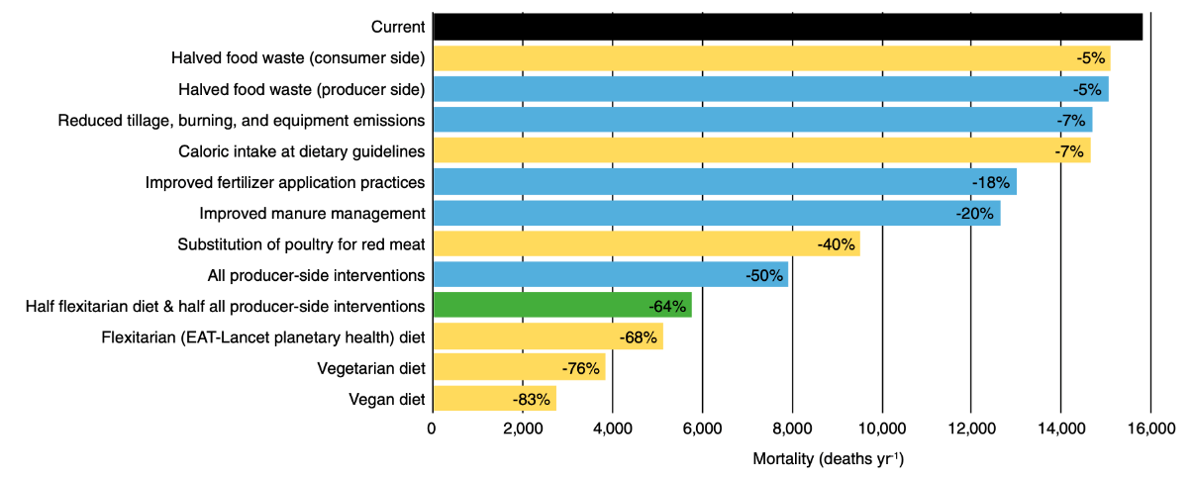
Domingo et al. (2021) PNAS

