Slide 1
Environmental Threats from Livestock Operations Growing – Under the Radar
Environmental Protection Network
10.15.2021
Craig Cox
Environmental Working Group

Slide 2
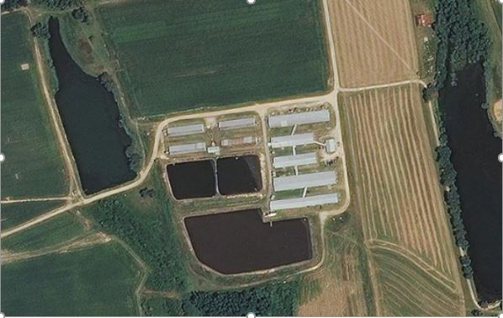
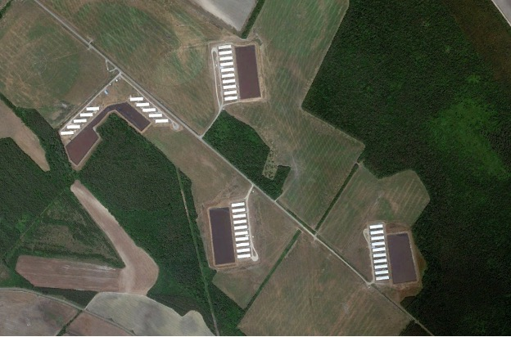
Under the Radar…
Industrial animal operations threats to health, drinking water, air quality, quality of life, climate have reached crisis proportions in communities surrounded by these operations.
Big problem…the growth and concentration of animal feeding operations on the landscape has gone on under the radar:
CWA Act permitting only captures a fraction of the operations and states vary dramatically on accessibility of that permit data AND any precise locations.
Census of Agriculture only provides gross county-level statistics, sometimes unreliable and usually out of date.
Can pierce the veil now thanks to…
Remote sensing – satellite and aerial imagery far more accessible.
Far better geographic data layers and geospatial software to do deeper analysis.

Slide 3
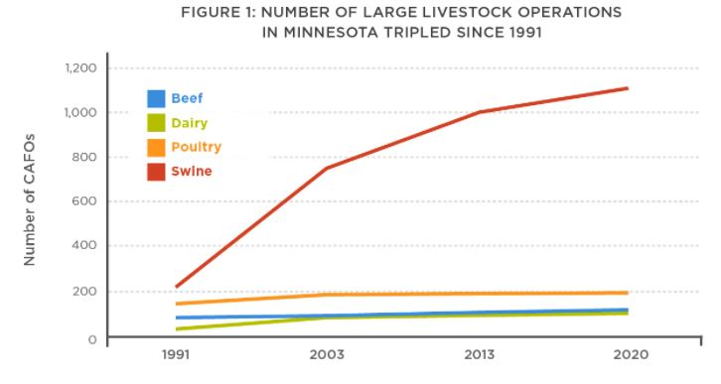
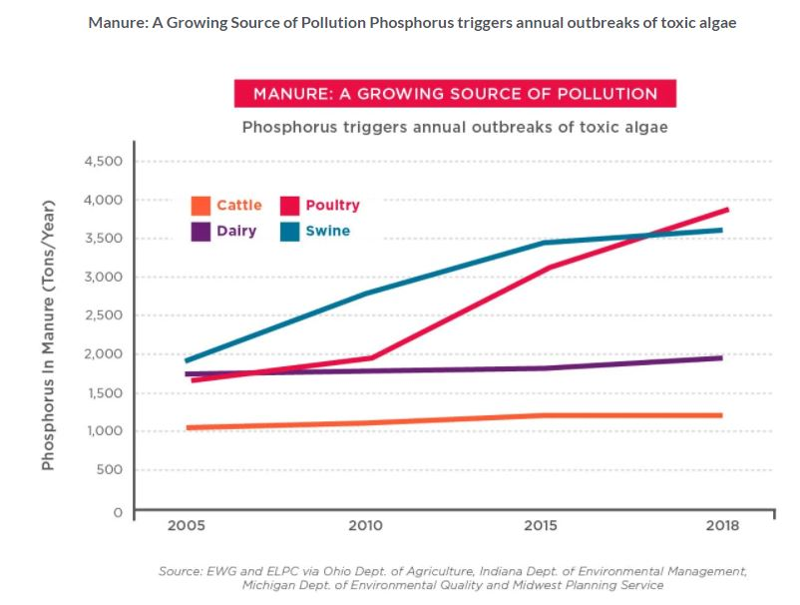
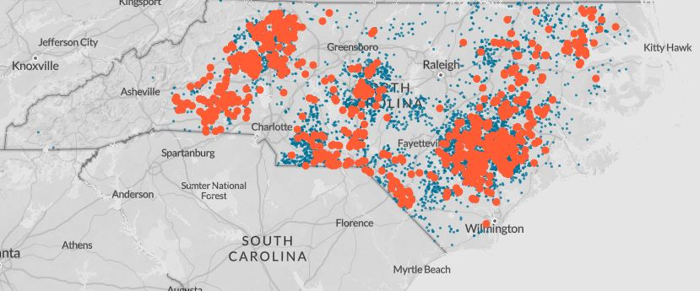
Operations are increasing, expanding and concentrating…
Notes:
Permit databases don’t capture the increase in operations or manure produced.
Operations below permit thresholds aren’t in the databases.

Slide 4
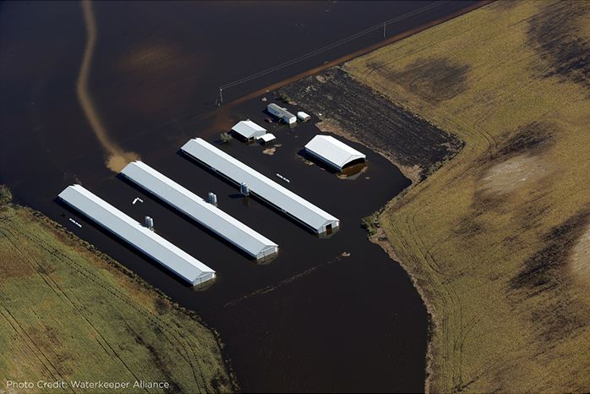
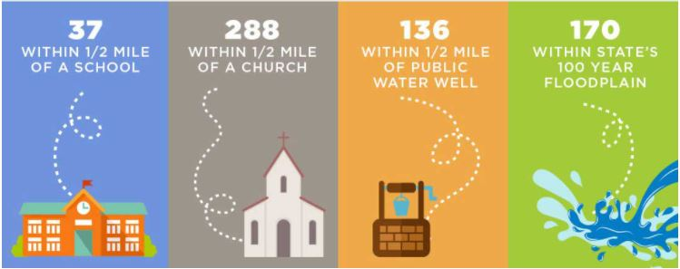
North Carolina
Concentrated in communities of color
And where climate change increases risk
Notes:
Precise locations help document who is affected – surrounded by livestock operations.
Coupled with census block data.

Slide 5
Ohio-Maumee River Watershed & Lake Erie
Permits based on size of operation = missing much of the problem…
Upshot – toxic drinking water
The amount of phosphorus added to the watershed from manure increased by 67 percent between 2005 and 2018.
In 2018 manure adds 10,610 tons of phosphorus to farm fields every year.
Meanwhile, phosphorus added in chemical fertilizers declined.
Notes:
79 percent of hog manure comes from unregulated farms.
So does 84 percent of cattle manure.

Slide 6
Minnesota: Manure overwhelms land, water and air
24,000 operations = waste from 95 million people
Cumulative effect of operations unassessed

Slide 7
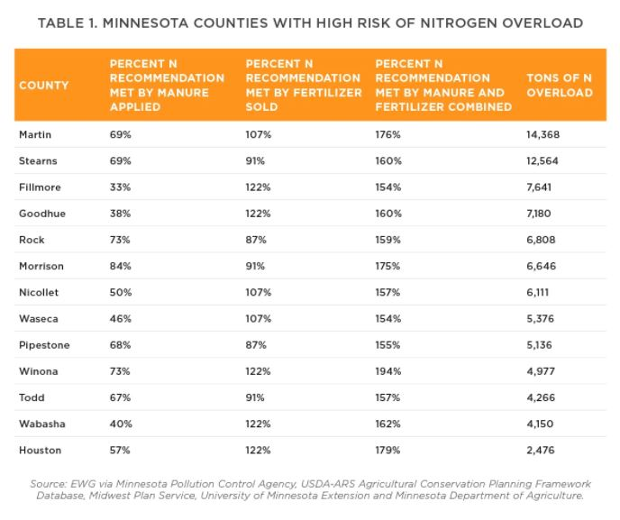
Minnesota: Cumulative Effect
Notes:
Nitrate in drinking water…
Ammonia
Nitrous oxide
Great deal of nitrogen volatilizes before it can be applied to fields.

Slide 8
Cumulative Effect…
Bacteria in state’s drinking water is ‘public health crisis’
Hundreds of thousands of Wisconsin residents are at risk of illness from waterborne pathogens in private and public drinking water supplies.
Sharply divided Iowa Supreme Court halts lawsuit over hog farm runoff
The majority said it is a legislative rather than a court decision.
Hundreds gather In Des Moines to demand Iowa moratorium on factory farms
Groups rally and lobby to protect Iowa’s water, rural communities, and independent family farmers
Air pollution from farms kills, report says
‘Big Milk’ Brings Big Issues for Local Communities
Mega-dairies are moving to Oregon, bringing concerns about their impacts on the state's rural communities, family farms, and environment
Baby’s death sparks water safety fight
Small-town Wisconsin residents take on state and powerful ag industry.
Overuse on cattle feedlots is a key factor in antibiotic resistance, report says
A Texas community chokes on fecal dust from cattle feedlots
And regulators aren't doing anything about it.
Animal Agriculture Costs More In Health Damage Than It Contributes To The Economy

Slide 9
Thank You
Craig Cox
Environmental Working Group
craig@ewg.org

