Slide 1
EPA’s Endocrine Disruptor Screening Program (EDSP)
Presented by Gary Timm, Penny Fenner-Crisp, Bill Jordan,
September 17, 2021

Slide 2
Overview
Background
    -Gary Timm
Implementation of the EDSP
    -Penny Fenner-Crisp
IG and EPN Recommendations for the Future of the EDSP
    -Bill Jordan

Slide 3
Endocrine System
The endocrine System is one of the major integrating and regulatory systems in humans and other animals
Hormones are natural secretory products of endocrine glands (ductless glands discharging directly to the blood)
Hormones control development, growth, metabolism and homeostatic mechanisms (e.g. blood pressure, ion concentrations, etc.)

Slide 4
Evidence for Endocrine Disruption
Epidemiological evidence in humans
Field studies of wildlife and fish
Experimental animals
Notes:
There are three main lines of evidence to support the environmental endocrine disruptor hypothesis. Epidemiological evidence linking human disease to endocrine disruption is the weakest. Experimental evidence the strongest.

Slide 5
Concern for Estrogens in the Environment
NIEHS Conferences on Estrogens in the Environment
Publication of Our Stolen Future
Congressional Hearings

Slide 6
EPA’s Legislative Mandates
(August 1996)
Food Quality Protection Act
  Must screen pesticides for estrogenic effects that may affect human health
  Must use appropriate validated test systems and other scientifically relevant information
  Can include other endocrine effects
Safe Drinking Water Act
  Can screen drinking water contaminants to which substantial numbers of persons are exposed

Slide 7
Endocrine Disruptor Screening and Testing Advisory Committee (EDSTAC)
Chartered Oct 16, 1996 (www.epa.gov/scipoly/oscpendo)
39 members representing broad constituencies
Recommendations proposed in 1998:
  Estrogen, androgen and thyroid
  Human and ecological effects
  Broad universe of chemicals
  Tier 1
    In vitro and in vivo screens
    Detect potential to interact with endocrine system
  Tier 2
    Multi-generation studies covering a broad range of taxa
    Confirm Tier 1 results and provide data for hazard assessment

Slide 8
The Universe of Chemicals
Chemicals Under EPA’s Purview:
~1300 pesticide active ingredients
~2500 “inerts” in over 20,000 pesticide products
~45,000 active industrial chemicals on the TSCA inventory
Unknown # of environmental contaminants
Unknown # of mixtures
Chemicals NOT Under EPA’s Purview:
cosmetics
food additives
nutritional supplements
pharmaceuticals

Slide 9
Proposed Tier I Screening Battery
In vitro Screens
  ER Binding / Reporter Gene Assay
  AR Binding / Reporter Gene Assay
  Steroidogenesis Assay with minced testis
In vivo Screens
  Rodent 3-day Uterotrophic Assay
  Rodent 20-day Pubertal Female Assay with Thyroid
  Rodent 5-7 day Hershberger Assay
  Frog Metamorphosis Assay
  Fish Gonadal Recrudescence Assay

Slide 10
Proposed Tier 2 Testing
Tests to include:
Two-Generation Mammalian Reproductive Toxicity Study
Avian Reproduction Test
Fish Life Cycle Test
Mysid Life Cycle Test
Amphibian Development and Reproduction Test

Slide 11
Validation Process
1. Method Development
  Comprehensive literature review
  Develop initial protocol
2. Pre-validation
  Demonstration of relevance
  Preliminary data on reliability
  Standardization of protocol
3. Validation in multiple laboratories
  Proof of relevance and reliability
4. Scientific Peer Review

Slide 12
EDSP Implementation
List 1 Data call-in:
Issued orders beginning in October, 2009, on 67 pesticide active ingredients and High Production Volume chemicals used as “inerts”
Received data on 52 chemicals; 15 chemicals cancelled or discontinued

Slide 13
EDSP Implementation-2
Results applying WoE guidance:
    20 chemicals- No effects seen
  14 chemicals showed potential interaction with one or more pathways, but no unreasonable risks were determined
  18 showed potential interaction with one or more pathways, but risk findings were not made
    All 18 showed potential action with thyroid pathway
    17 showed potential action with androgen pathway
    14 showed potential interaction with estrogen pathway
    All 18 recommended for Tier 2 testing, but orders never issued

Slide 14
EDSP Implementation-3
List 2 published in 2014 in response to House Appropriations Comm. report
  Contained 109 chemicals
    41 pesticide active ingredients
    68 SDWA chemicals, including
      2 PFAS
      4 pharmaceuticals
      A variety of industrial chemicals including those used for industrial manufacturing processes, plasticizers, and in the production of pharmaceutical and personal care products (PCPs)
  Despite HAC direction to issue 25 DCIs/year, no action was taken to obtain screening data

Slide 15
Reengineering the Program
Realization that processes of chemical prioritization, issuance of DCIs, assay development and validation, and data review were overwhelming the resources available to carry out the program
The solution? Implement the recommendations in the 2007 NAS report Toxicity Testing in the 21st Century and revise the approach, using computational toxicology tools such as ToxCast and high throughput technologies (NAMs)

Slide 16
NAMs
NAMs = “New Assessment Methods”
Defined as “any technology, methodology, approach, or combination thereof that can be used to provide information on chemical hazard and risk assessment that avoids the use of intact animals.”
2016 TSCA obligates OPPT to publish annually the list of NAMs used by the program
2020 EPA Work Plan developed after 2019 Wheeler memo issued

Slide 17
Revised Tier I Screening Battery
Estrogen: 18 HTP screens + ER pathway model
Androgen: 11 HTP screens + AR pathway model
Thyroid: Still under development
Steroidogenesis: updated HTP H295R assay
Aromatase: HTP assay developed

Slide 18
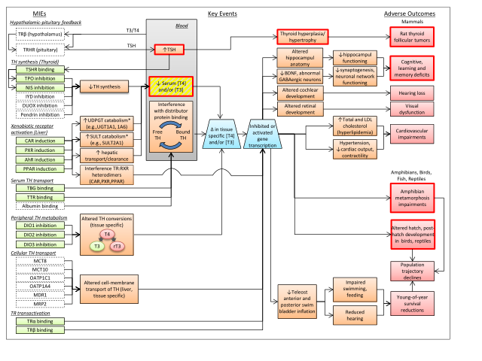
Thyroid: High Level of Complexity

Slide 19
EPN Proposed Path Forward
1.Decide on the screening assays to be used
  We recommend use of newer second-generation screening batteries for E, A and T, steroidogenesis and aromatase
2. Establish the priority order in which substances will be screened. We recommend the following order:
    Pesticide active ingredients
    Intentionally added inert ingredients in pesticide products
    Substances meeting SDWA criteria
    Other industrial chemicals regulated under TSCA

Slide 20
EPN Proposed Path Forward-2
3. Determine the most appropriate approach for obtaining the necessary initial screening data
  Option 1: Require regulated entities to conduct the screening via DCIs under FIFRA or test rules/ negotiated testing agreements under TSCA
  Option 2: If EPA imposes data requirements on regulated entities, a series of public-private partnerships for generating required data could be an alternative approach to chemical-specific private-entity consortia.
  Option 3: EPA could conduct the screening itself
  We favor requiring regulated entities to conduct the screening

Slide 21
EPN Proposed Path Forward-3
4. Consider the need to develop and publish updated/revised criteria for interpreting and using the results of the initial Tier 1 screening batteries
  Are the results of a battery “positive” or “negative?”
  What testing is required if a battery is “positive?”
  Add all new data to ED database
  For pesticide active ingredients, incorporate results into Registration Review documents

Slide 22
EPA Response & OIG Report
On 8/30/21, OCSPP AA Freedhoff replied to the EPN letter, thanking EPN and referring to the 7/28/21 OIG report on EDSP
The OIG recommended ten corrective actions; OCSPP agreed to all and set a schedule over the next several years.

Slide 23
OIG Recommendations
Establish communication SOP with other EPA offices involved with EDSP – 9/30/21
Update EDSP 2015 notice – 12/31/21
Update the EDSP website – 12/31/21
Develop a strategic plan for EDSP – 9/30/22
Conduct annual program reviews – 9/30/22
Seek public review of revised approach to determining whether T1 is positive for eco-effects – 12/31/23

Slide 24
OIG Recommendations-2
Decide whether to make T1 (or NAMs) part of new AI data requirement – 9/30/24
Issue DCIs for Tier 2 (T2) studies on List 1 chemicals that tested positive in T1 - 9/30/24
Develop performance measures for EDSP – 10/1/24
Issue DCIs / test orders for Tier 1 (T1) studies on List 2 chemicals – 9/30/25

Slide 25
EPN & OIG
The OIG report and EPN’s letter agree that EPA needs to restart the stalled EDSP, but emphasize different strategies
  OIG: follow through on the EDSTAC scheme and exposure-based priorities
  EPN: use NAMs both to set priorities and to screen; focus on statutory duty to evaluate pesticide actives, then inerts, and then other chemicals under SDWA

