Slide 1
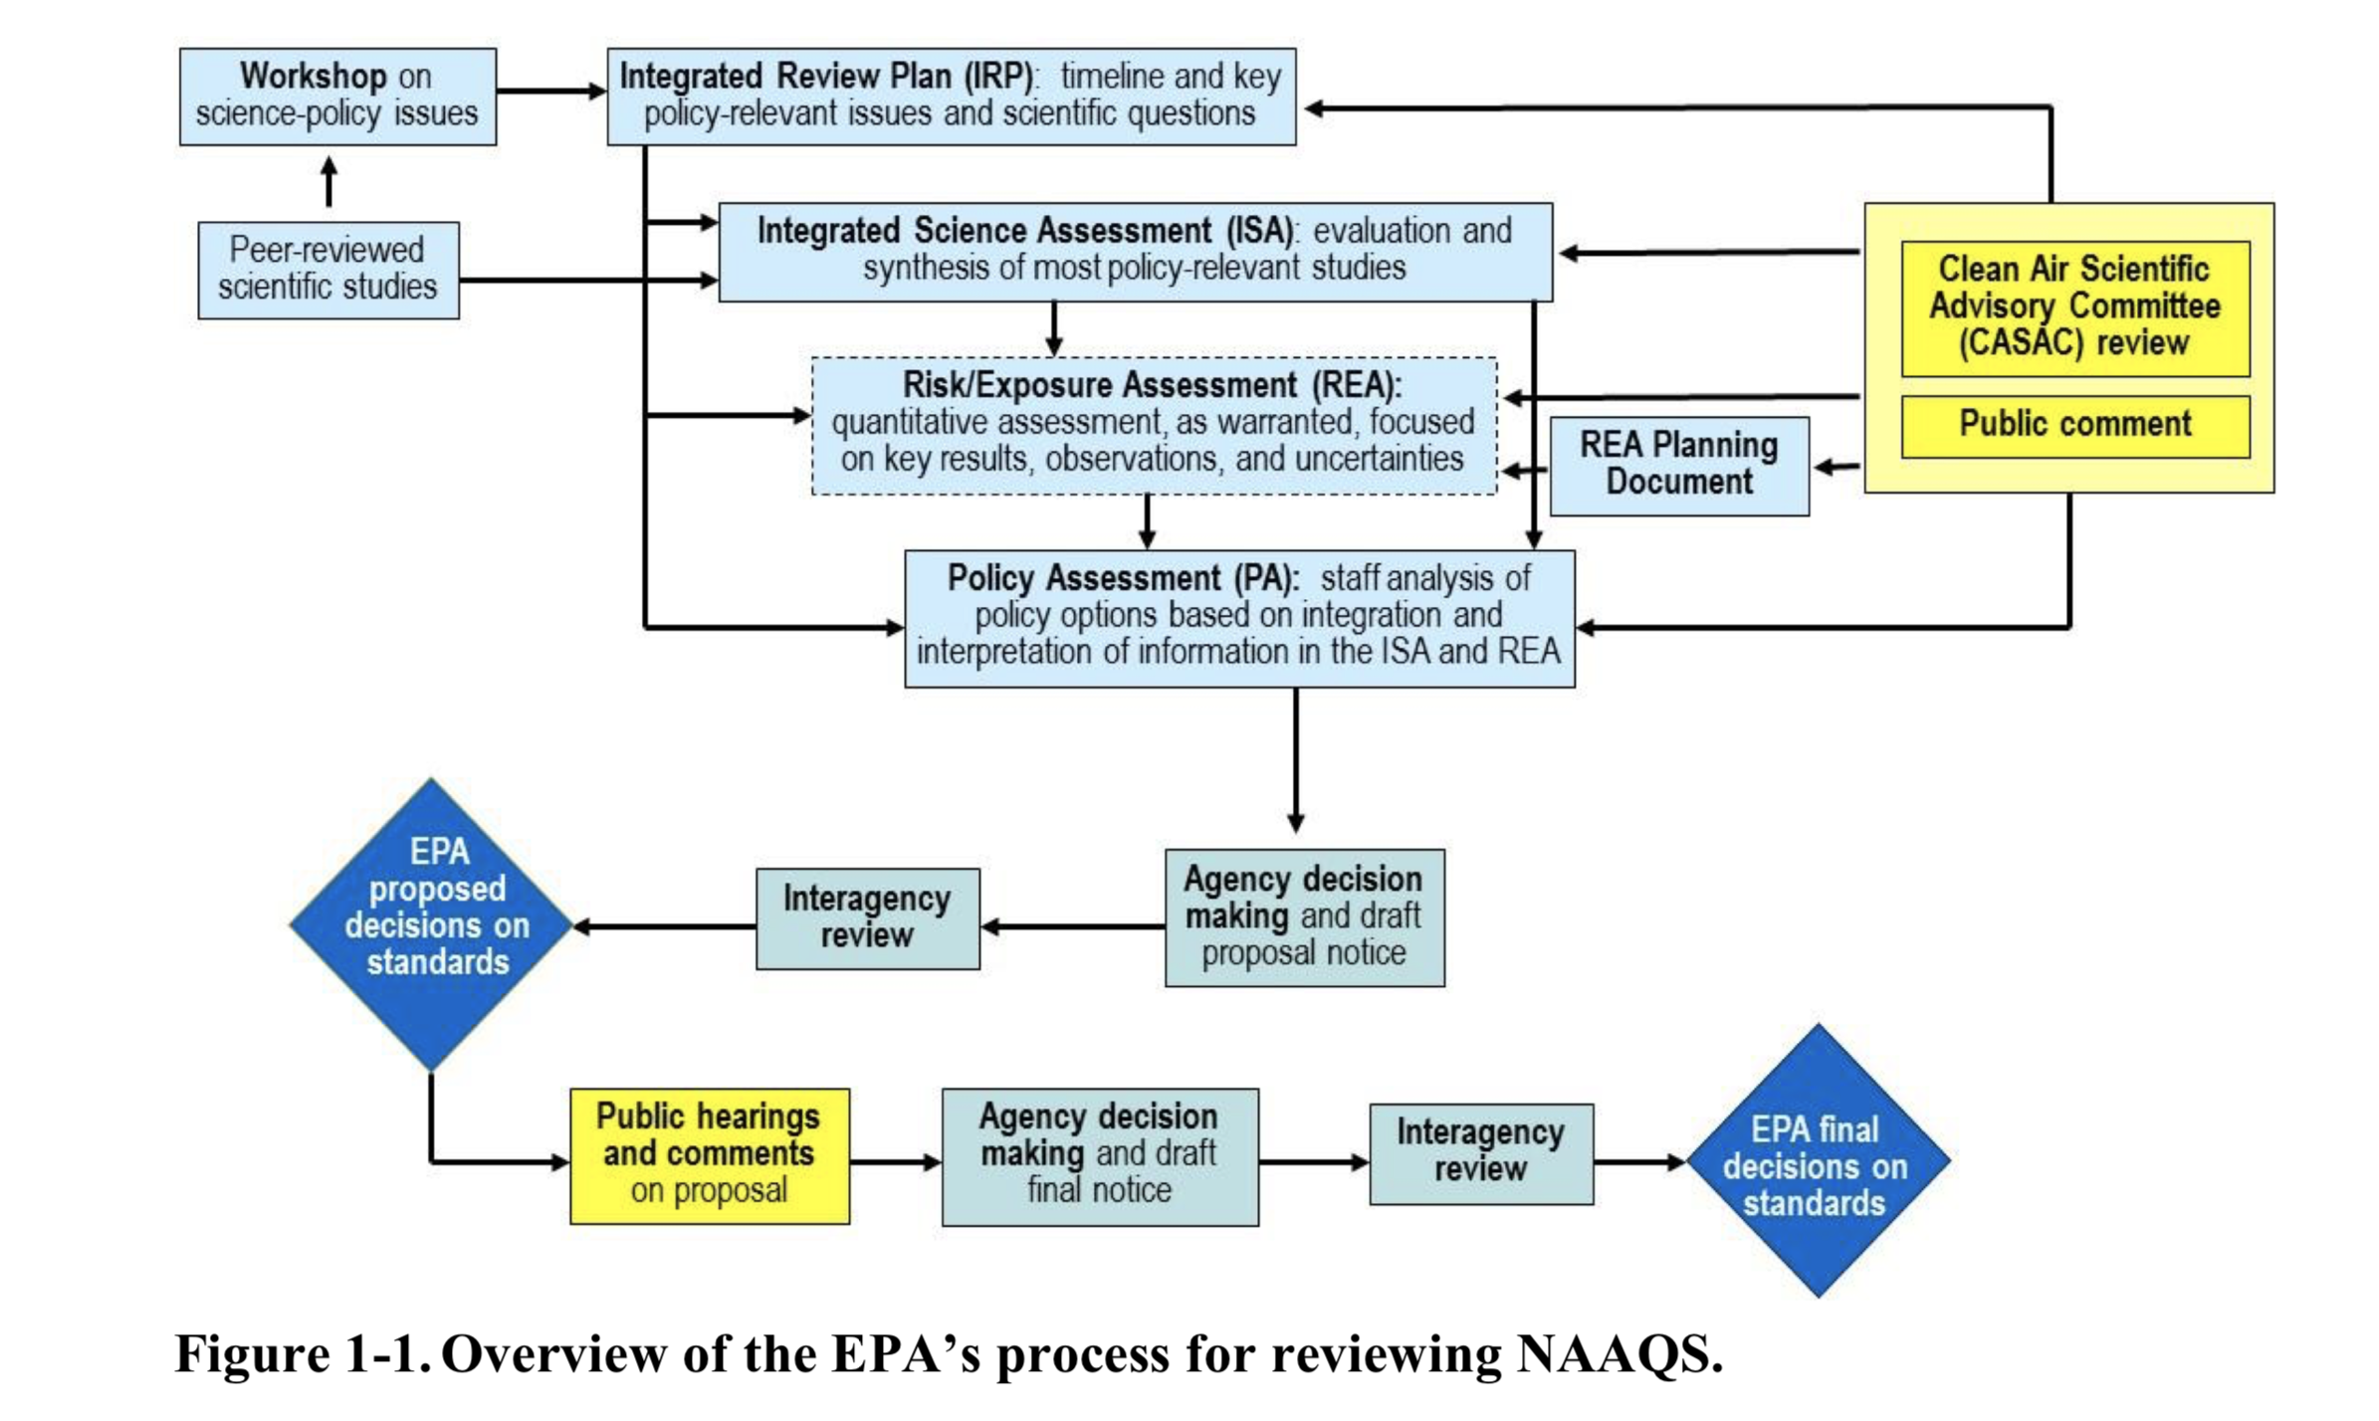

Slide 2
Anatomy of Air Quality Standards
Key issues in criteria (S.108) and NAAQS (S.109)
Based on the latest scientific criteria….
Are the current/new standards requisite to protect public health with an adequate margin of safety
Do the standards protect public welfare (the environment, climate, materials, visibility, ecosystems….)
Costs of controlling pollution are not considered
The four major components of air quality standards
Indicator - i.e. what is measured (O₃, TSP, PM_{2.5…}) and FRM
Averaging time - 1-hr, 8-hr, 24-hr, annual
Form - statistic – e.g. exceedance, concentration based
Level – e.g. 15 ug/m³ (PM), 0.08 ppm O₃ (gases)
The relative protection afforded by a “suite” of NAAQS is a function of all components for all standards combined

Slide 3
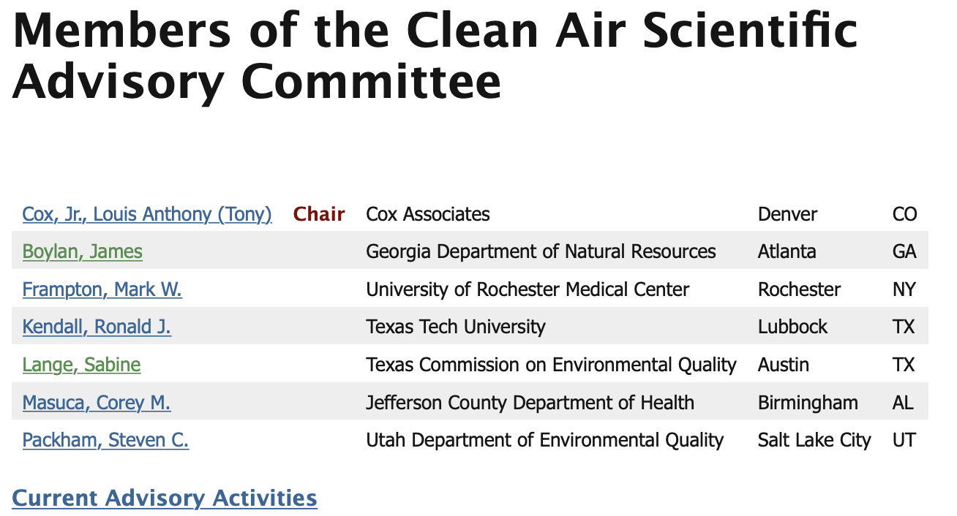

Slide 4
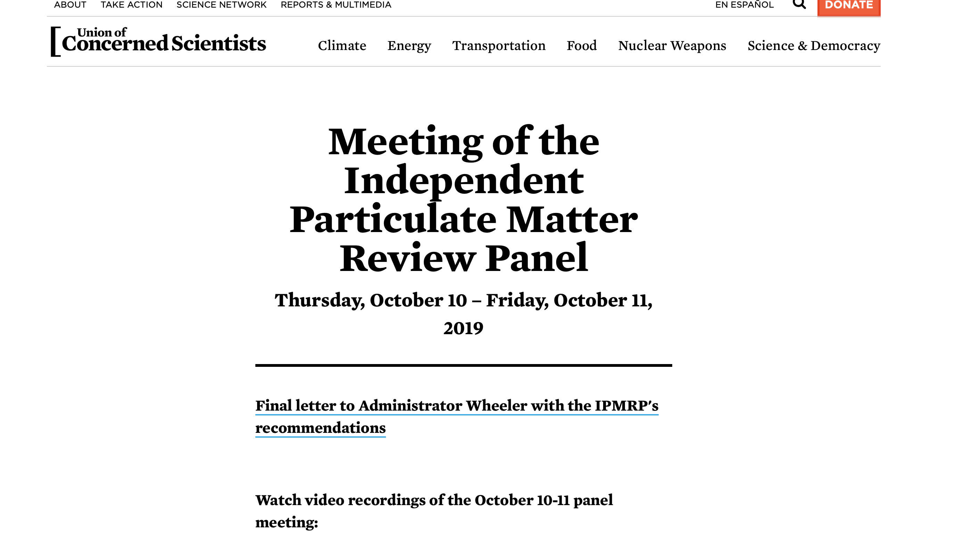
https://www.ucsusa.org/meeting-independent-particulate-matter-review-panel

Slide 5
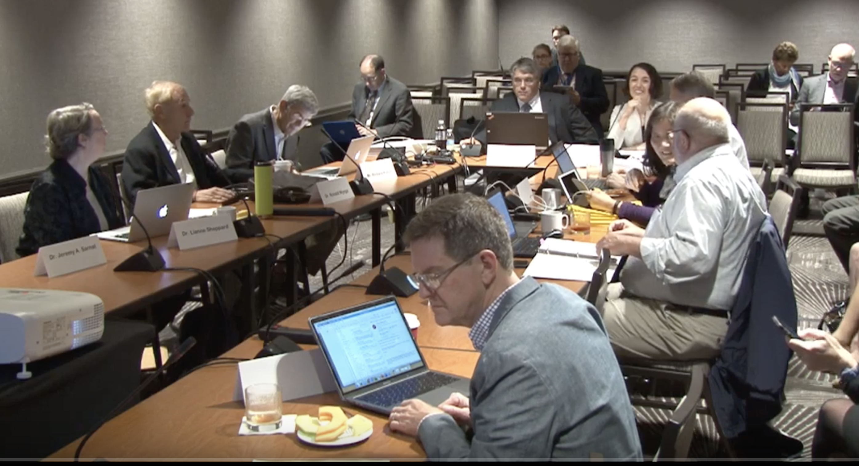

Slide 6
