Slide 1
The Clean Air Act is Alive and Well Wisconsin v. EPA DC Circuit, September 13, 2019 Janet McCabe EPN Presentation, October 18, 2019

Slide 2
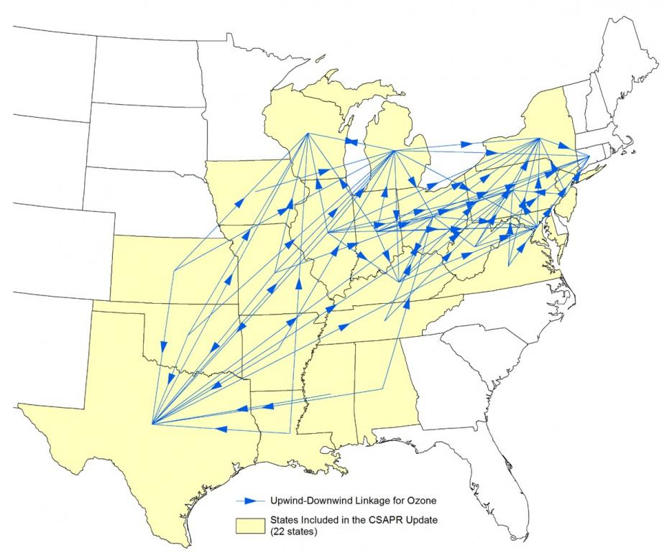
How to make everyone happy while cleaning up the air…
Takers anyone?
Source: EPA https://www.epa.gov/airmarkets/final-cross-state-air-pollution-rule-update-benefits-information-and-maps

Slide 3
High level takeaways
Court generally affirms EPA’s use of the CSAPR framework in the Transport Update role (“daughter of CSAPR”) for addressing interstate pollution
…and EPA’s approach to maintenance
…and approach to evaluating cost and benefit
…and approach to handling off-shore emissions
…but finds that EPA should have addressed all the upwind contribution and did not do so.
Notes:
Srinivasan, Millett, Wilkins—all Obama appointees
Per curiam decision
Chevron alive and well
EPA explanations thorough and shows reasoned decisioni-making
String of cases on this topic have given EPA a real roadmap of what not to do
At least 24 separate objections discussed in the opinion

Slide 4
Background
EPA has addressed eastern US interstate ozone and PM pollution through a series of rules:
NOx SIP call
Clean Air Interstate Rule
Cross-State Air Pollution Rule (CSAPR…one of the worst acronyms ever)
Transport Rule (or CSAPR Update Rule)
This multi-decadal effort has spawned an impressive body of caselaw, many legal careers, and significant improvements in air quality.

Slide 5
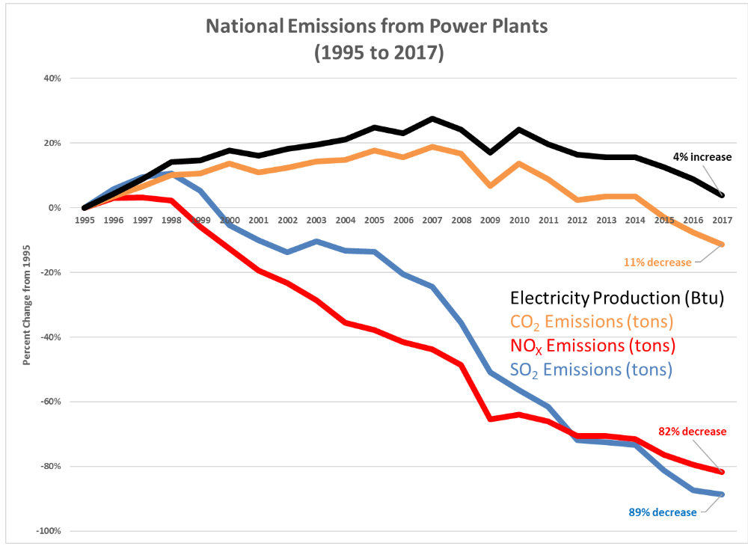
https://www.epa.gov/airmarkets/eight-things-know-program-highlights

Slide 6
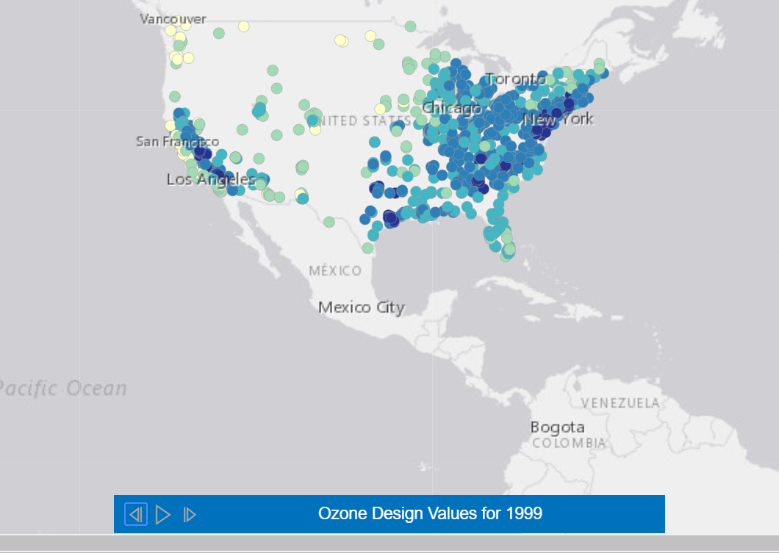
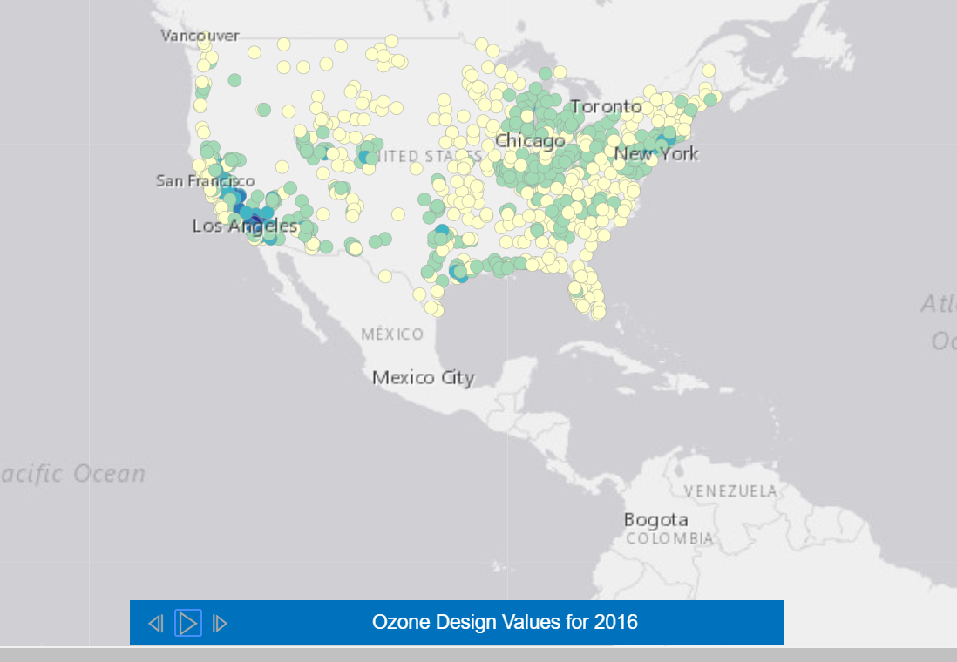
https://www.epa.gov/airmarkets/eight-things-know-program-highlights

Slide 7
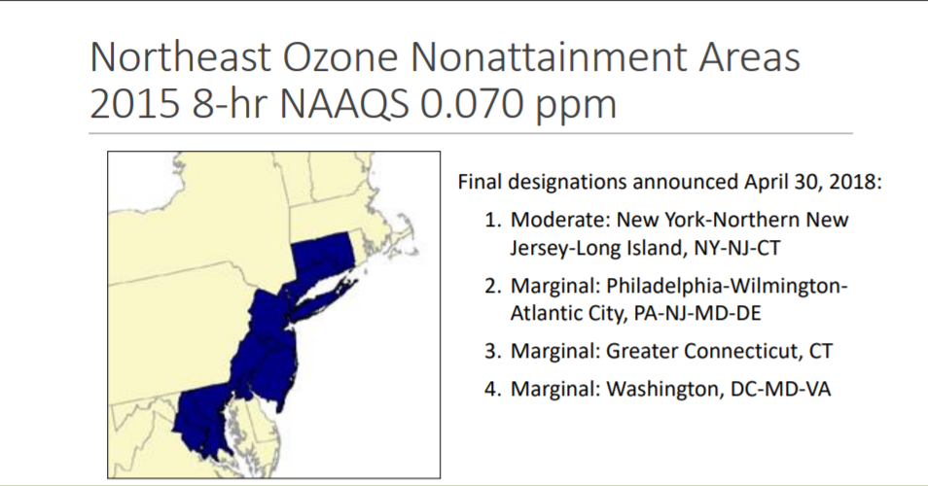
Source: NESCAUM, !2/2018, http://www.nescaum.org/topics/ozone

Slide 8
The statutory provisions
Clean Air Act Section 110(a) says that states must implement plans (State Implementation Plans) to attain and maintain the air quality standards by deadlines established by EPA rules.
Clean Air Act Section 110(a)(2)(d) says that upwind states must control pollution that keeps downwind states from attaining or maintaining healthy air.
For some downwind states, EPA has determined that as much as 75% of ozone-causing pollution comes from out of state
For many years, EPA has helped states to meet their interstate obligations through federal power plant reduction rules and “friendly” FIPs (federal implementation plans)

Slide 9
Context and goals of the 2016 CSAPR Update Rule
Some states were facing a 2018 deadline to meet the 2008 ozone standard or risk bump up, and could not meet it without upwind reductions.
That meant a relatively short amount of time for reductions to be implemented (focus on power plant reductions that could be implemented quickly, not other big NOx sources).
EPA wanted to get a rule in place quickly to achieve as much reduction as could reasonably be done by 2018 or earlier.
Litigation over Good Neighbor Rules has been incessant and protracted (including all the way to the Supreme Court for CSAPR)
EPA wanted to get a rule in place that used the Court-sanctioned methodology a second time to cement it as a legal and workable approach.

Slide 10
Elements of the 2016 Transport Update Rule
Step 1: EPA projected ozone nonattainment areas in 2017 and areas at risk of nonattainment (“maintenance areas”).
Step 2: EPA identified upwind areas linked to these downwind predicted nonattainment areas
Step 2a: States contributing more than 1%
(0.75ppb) were deemed to “significantly
contribute”

Slide 11
Step 3: EPA calculated the amount of reduction that could be achieved as different price points ($800/$1400/$3400/$5000/$6400 per ton)
$1400/ton reductions maximized downwind air quality improvement with respect to control costs
Step 3a: EPA made sure that no state would be controlling more than its contribution (no overcontrol)
Step 4: EPA calculated each state’s budget, reflecting NOx emissions that could be achieved at $1400/ton
NOx budget to be implemented through an allowance and trading program
Limits to make sure that no state significantly exceeds its budget (the 121% “assurance level”)

Slide 12
Major Finding #1: The Rule is inconsistent with the Act’s attainment deadlines
By only providing a “partial remedy,” it allows upwind states to continue contributing to downwind nonattainment beyond those states’ attainment deadlines (in this case, 2018).
EPA admitted this. It said the rule required a “subset of each State’s emission reduction obligation” and represents only a “first, partial step to addressing a given upwind State’s significant contribution…”
Downwind states have a deadline to meet, but are only getting part of the upwind contributions addressed, putting them in a very difficult position
Consistent with the finding in North Carolina v. EPA, which rejected CAIR, and with a Chevron analysis, EPA has failed to require enough upwind reductions to enable downwind states to meet their attainment deadlines.

Slide 13
Court rejects EPA’s arguments…
Lack of enough information to extend rule to emitting sources beyond power plants is no excuse
Affirms prior holdings that “scientific uncertainty” cannot excuse compliance with a statutory mandate
Affirms prior holdings that “administrative infeasibility” likewise does not provide an excuse
EPA’s incremental approach doesn’t work when there is a specific statutory deadline
Time crunch caused by endless litigation not an excuse either.
Sorry, EPA…..

Slide 14
Major Finding #2: EPA’s treatment of maintenance areas
A key finding in North Carolina v. EPA that sent CAIR back: the maintenance prong must be given “independent effect.”
EPA and states can’t just assume that if you take care of nonattainment, you also take care of maintenance.
Court rejected arguments that requiring reductions because of maintenance concerns must necessarily be overcontrol, or that areas that monitor attainment can’t be considered downwind receptors under the Good Neighbor Rule:
The Update Rule “… gives effect to the upwind States’ independent duty not to impede downwind States’ maintenance of air quality standards.”

Slide 15
Major Finding #3: Consideration of costs and benefits
Approves EPA’s consideration of costs and benefits
$1400/ton reasonable even for Wisconsin, which has a small actual impact downwind; and just because the impacts are small relative to other states’ contributions, it doesn’t mean they aren’t significant to the downwind state.
Numerous references by the court to the fact that this is a collective problem, contributions from some are necessarily going to be small---that’s what Congress recognized in the Good Neighbor provision.

Slide 16
Major Finding #4: EPA’s choices about numerous technical issues were reasonable and well explained
How to model off shore grid cells
What specific datasets to use (modeling, monitoring, reduction efficiency)
How to consider international and biogenic emissions
How to calculate state budgets and treat carryover allowances
Specific issues related to specific units
Court confirms that very specific overcontrol complaints need to be brought as specific actions.

Slide 17
Major Finding #5: Unit-specific challenges should be brought in individual requests
Follow CSAPR court approach that issues related to specific units and data are to be resolved through individual petitions, not in the overall challenge to the rule.
_________________________________________________________
Numerous other claims were dealt with summarily.

Slide 18
Danger spot?
Court notes that EPA has discretion to decide how much contribution is “significant” and must be abated.
Signal that EPA could establish a “significant contribution” threshold other than 1%, which of course is true—it could
And EPA has already floated that idea: 8/31/18 memo from Tsirigotis to states that analyzes the effects of using 1% (0.70 ppb), 1 ppb or 2 ppb.

Slide 19
Next steps and fallout
EPA must respond to court’s direction that the rule address all nonattainment and maintenance with 2008 ozone standard
Note that the 2015 ozone NAAQS prompts new Good Neighbor obligations, which states need to address in SIPs. It may make sense for EPA to do another increment of a federal rule (and perhaps FIP).
EPA had relied on the CSAPR Update rule to declare 20 states’ Good Neighbor obligations fully resolved: December 2018 “Closeout Rule”
That finding is now in question.

